Slide 1
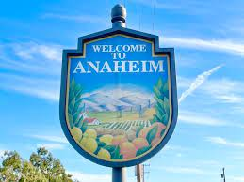
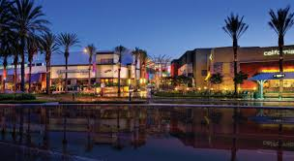
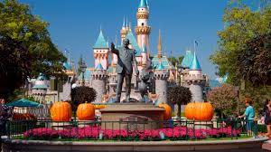
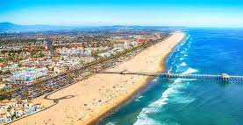
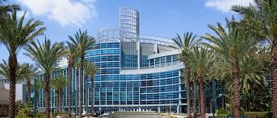
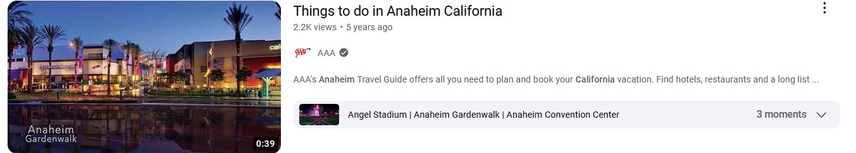
Current Weather For Anaheim
Welcome to Anaheim, California! This vibrant city in Orange County is renowned for its sunny weather, thrilling attractions, and lively entertainment. Whether you're a Disney fan, sports enthusiast, or simply looking to explore Southern California, Anaheim has something for everyone. Here are some top things to do:
Disneyland Resort: Experience the magic of Disneyland Park and Disney California Adventure Park, filled with beloved characters, thrilling rides, and captivating parades and fireworks.
Downtown Disney District: Enjoy shopping, dining, and entertainment in this lively district situated between the Disneyland parks. Explore shops, indulge in delicious cuisine, and catch live music.
Angel Stadium of Anaheim: Cheer for the Los Angeles Angels and immerse yourself in the excitement of a baseball game. Take a stadium tour to get behind-the-scenes insights.
Honda Center: Attend live events, sports games, or concerts at this popular venue, home to the Anaheim Ducks hockey team.
Anaheim Packing District: Delight your taste buds with a visit to this foodie paradise, offering a diverse range of dining options in a lively setting.
Flightdeck Flight Simulation Center: Experience the thrill of flying in realistic flight simulators, allowing you to pilot fighter jets and engage in aerial dogfights.
Muzeo Museum and Cultural Center: Immerse yourself in art and culture with thought-provoking exhibits, showcasing contemporary art and historical artifacts.
Yorba Regional Park: Escape the city and relax in the tranquility of nature. Enjoy walking trails, picnicking, paddleboat rentals, and outdoor activities.
Embrace the magic and excitement that awaits you in Anaheim, California. Have a fantastic time exploring all the city has to offer!

Slide 2
Current Weather For Anaheim
Welcome to Anaheim, California! This vibrant city in Orange County is renowned for its sunny weather, thrilling attractions, and lively entertainment. Whether you're a Disney fan, sports enthusiast, or simply looking to explore Southern California, Anaheim has something for everyone. Here are some top things to do:
Disneyland Resort: Experience the magic of Disneyland Park and Disney California Adventure Park, filled with beloved characters, thrilling rides, and captivating parades and fireworks.
Downtown Disney District: Enjoy shopping, dining, and entertainment in this lively district situated between the Disneyland parks. Explore shops, indulge in delicious cuisine, and catch live music.
Angel Stadium of Anaheim: Cheer for the Los Angeles Angels and immerse yourself in the excitement of a baseball game. Take a stadium tour to get behind-the-scenes insights.
Honda Center: Attend live events, sports games, or concerts at this popular venue, home to the Anaheim Ducks hockey team.
Anaheim Packing District: Delight your taste buds with a visit to this foodie paradise, offering a diverse range of dining options in a lively setting.
Flightdeck Flight Simulation Center: Experience the thrill of flying in realistic flight simulators, allowing you to pilot fighter jets and engage in aerial dogfights.
Muzeo Museum and Cultural Center: Immerse yourself in art and culture with thought-provoking exhibits, showcasing contemporary art and historical artifacts.
Yorba Regional Park: Escape the city and relax in the tranquility of nature. Enjoy walking trails, picnicking, paddleboat rentals, and outdoor activities.
Embrace the magic and excitement that awaits you in Anaheim, California. Have a fantastic time exploring all the city has to offer!

Slide 3
Current Weather For Anaheim
Welcome to Anaheim, California! This vibrant city in Orange County is renowned for its sunny weather, thrilling attractions, and lively entertainment. Whether you're a Disney fan, sports enthusiast, or simply looking to explore Southern California, Anaheim has something for everyone. Here are some top things to do:
Disneyland Resort: Experience the magic of Disneyland Park and Disney California Adventure Park, filled with beloved characters, thrilling rides, and captivating parades and fireworks.
Downtown Disney District: Enjoy shopping, dining, and entertainment in this lively district situated between the Disneyland parks. Explore shops, indulge in delicious cuisine, and catch live music.
Angel Stadium of Anaheim: Cheer for the Los Angeles Angels and immerse yourself in the excitement of a baseball game. Take a stadium tour to get behind-the-scenes insights.
Honda Center: Attend live events, sports games, or concerts at this popular venue, home to the Anaheim Ducks hockey team.
Anaheim Packing District: Delight your taste buds with a visit to this foodie paradise, offering a diverse range of dining options in a lively setting.
Flightdeck Flight Simulation Center: Experience the thrill of flying in realistic flight simulators, allowing you to pilot fighter jets and engage in aerial dogfights.
Muzeo Museum and Cultural Center: Immerse yourself in art and culture with thought-provoking exhibits, showcasing contemporary art and historical artifacts.
Yorba Regional Park: Escape the city and relax in the tranquility of nature. Enjoy walking trails, picnicking, paddleboat rentals, and outdoor activities.
Embrace the magic and excitement that awaits you in Anaheim, California. Have a fantastic time exploring all the city has to offer!

